Slide 1
Machine Learning Project
Legal Outcome Predictor: Analyzing Court Cases with Machine Learning
Sourav Kumar Singh

Slide 2
Legal Outcome Predictor: Analyzing Court Cases with Machine Learning.
Introduction:
This project aims to predict the outcomes of legal cases using various features extracted from case data. The code demonstrates how to preprocess and analyze a dataset containing information about legal cases, including facts of the case, issue areas, decision types, and dispositions. It involves steps such as reading the data, encoding categorical variables, handling missing values, and preparing the data for model training.
The project employs a Random-Forest-Classifier, a powerful machine learning model, to predict whether the first party or the second party wins in each case. Additionally, it includes text processing with TF-IDF vectorization for the 'facts' column of the dataset and evaluates the model's performance using accuracy metrics and feature importance analysis.
This project showcases how machine learning can be applied in the legal domain to assist in understanding and predicting case outcomes.

Slide 3
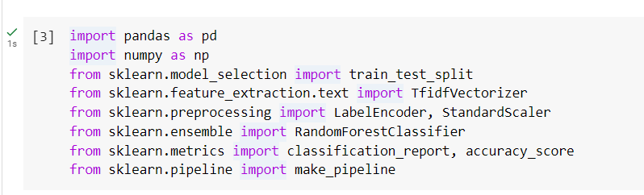
Important Libraries to import:

Slide 4
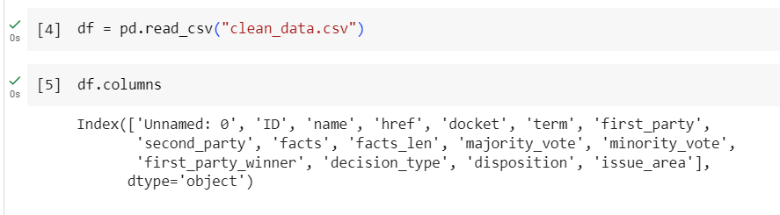
Implementing Code:
Reading Data:
The code starts by reading a CSV file named "clean_data.csv" into a Data Frame ‘df’. This file likely contains data about legal cases, including facts, issues, decision types, dispositions, and information about which party won.

Slide 5
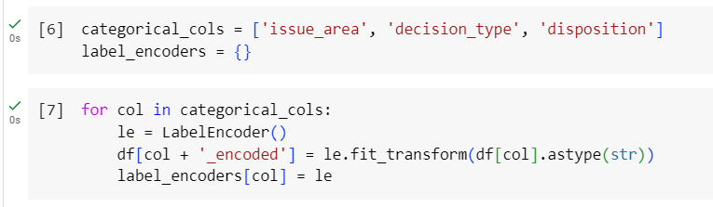
Encoding Categorical Data:
The code identifies three categorical columns:
'issue_area', 'decision_type', and 'disposition’.
We have used LabelEncoder for each of these columns.
This process converts the categorical text data into numerical form, which is easier for machine learning algorithms to process.

Slide 6

Data Cleaning:
The code removes rows from ‘df’ where the 'first_party_winner' column has missing values, ensuring that the analysis only includes complete cases.

Slide 7
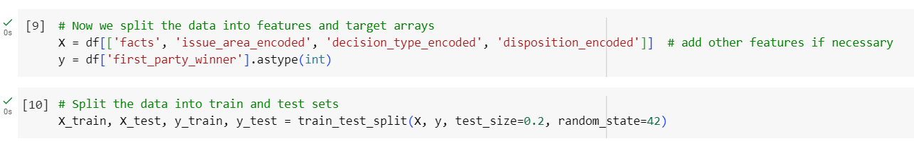
Preparing Data for Model:
The code selects certain columns to be features (X) and 'first_party_winner' as the target variable (y).
The features include the text from the 'facts' column and the encoded versions of 'issue_area', 'decision_type', and 'disposition'.

Slide 8
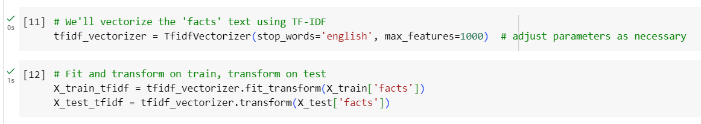
Text Vectorization:
A TfidfVectorizer is used to convert the 'facts' text data into a numerical form using the TF-IDF technique. This technique evaluates how important a word is to a document in a collection of documents.
The TF-IDF values for the training set are calculated using fit_transform, and for the test set using transform.

Slide 9
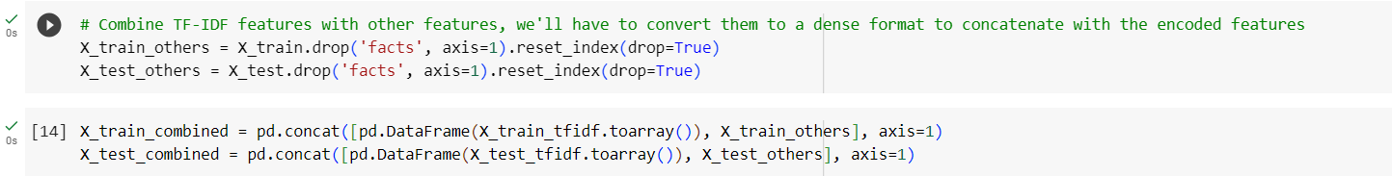
Combining Data:
The non-text features are separated from the 'facts' column and the indices are reset.
The TF-IDF data and the other features are combined to form the final training and test datasets.

Slide 10
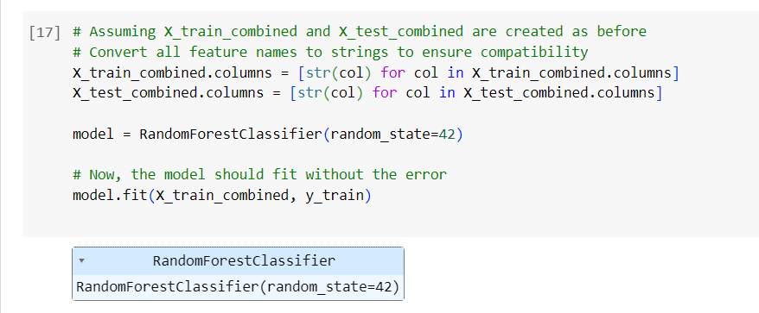
Model Training:
A RandomForestClassifier model is initialized and trained using the combined training data.

Slide 11
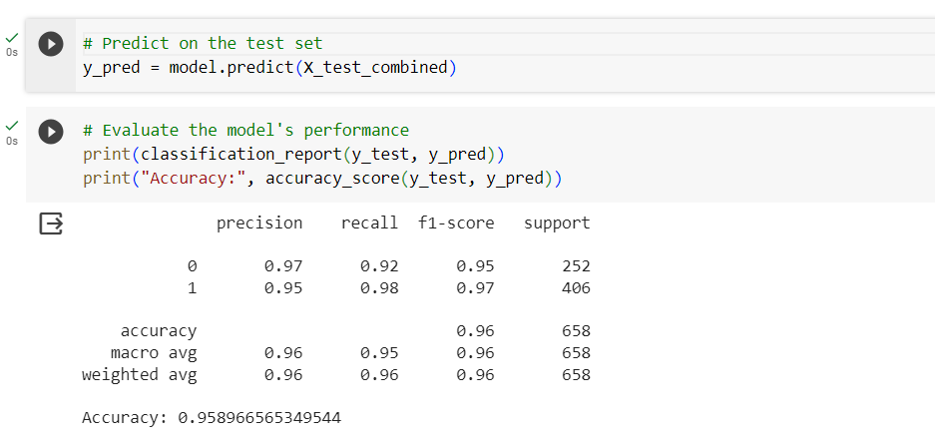
Model Evaluation:
The trained model is used to predict outcomes on the test set.
The performance of the model is evaluated using a classification report and accuracy score.

Slide 12
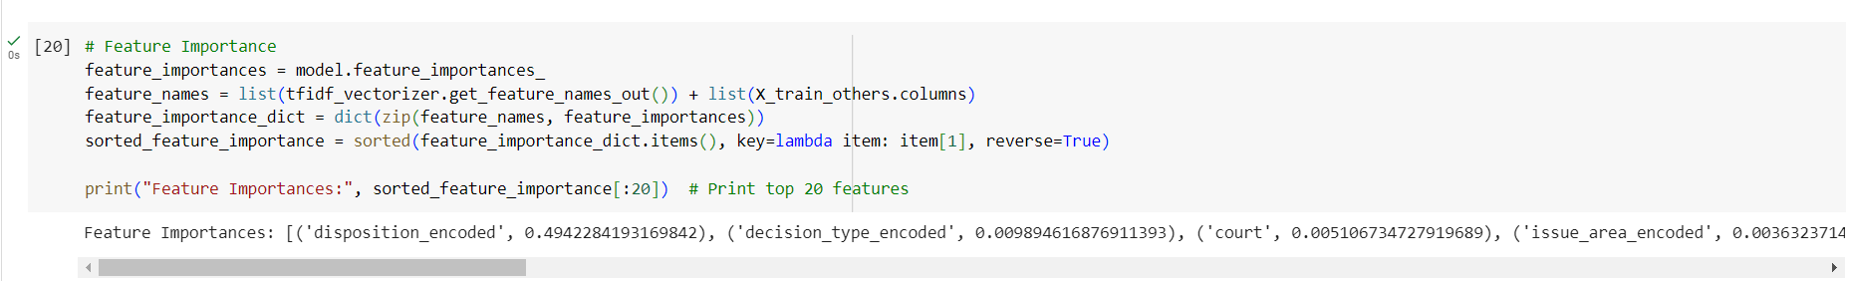
Feature Importance:
The importance of each feature in the model is extracted and displayed. This shows which features have the most influence on the model's predictions.

Slide 13
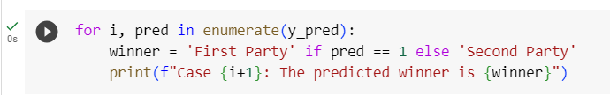
Making Predictions:
Finally, for each case in the test set, the code predicts whether the first or second party is the winner and prints this prediction.

Slide 14
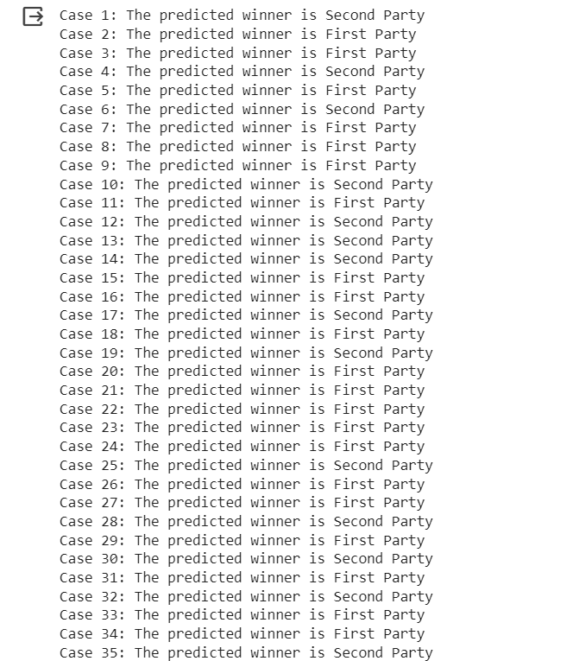
Predictions:

Slide 15
Total of 658 cases are predicted.
We have used machine learning pipeline, where data is read, preprocessed, and used to train a model, which is then evaluated and used to make predictions.

Slide 16
You can refer to this code…!!!!
You use this code in various fields.
Healthcare and Medical Diagnosis.
2. Finance and Credit Scoring.
3. Customer Behavior Analysis in Retail.
4. Supply Chain and Inventory Management.
5. Sports Analytics.
6. Social Media and Sentiment Analysis.

